Slide 1
Project Forecast Trading Multiples Prediction using Regression 17 December 2018

Slide 2
1. Executive Summary (1/1)
Project Overview
Objective: To determine if there is a statistically significant relationship between a company’s EV/TTM Revenue multiple and various other defining characteristics and whether that relationship can be used for predictive purposes.
Scope: The project’s analysis and predictive parameters are optimized for late-stage, high-growth B2B software companies.
Result: There appears to be statistically significant relationships between a company’s characteristics and their valuation that can be used as a predictive model. However, the results are not entirely reliable and still subject to discretion as the methodology is developed further
Screening Universes
Selected Features
A
Databricks Main Comps – 19 companies originally identified for studying and comparison for Project Tetris.
Dependent Variable | EV/TTM Revenue Multiple
Independent Variables | TTM Revenue Growth Rate (%) NTM Revenue Growth Rate (%) TTM Gross Margin (%) TTM S&M % of Revenue (%) TTM EBITDA Margin (%) Cash % of Revenue (%)
B
Bessemer Emerging Cloud Index – 46 emerging public companies primarily involved in providing cloud software and services to their customers.
C
Public Software Companies – 120 publicly listed companies¹ with a market cap <USD20bn and >USD200mn.
Methodology
Summary of Findings
Data Preparation: The dataset was condensed from 185 total companies across universes A, B, C to 122 after removal of duplicates and companies with incomplete data.
Feature Selection: Relevant features were analyzed and selected using a feature ranking matrix created through the application of several machine learning algorithms. All original features were pulled from Bloomberg. 6 of 19 features were selected for the model.
Model Preparation: 17 regression models were used for an initial screening with 5 K-Fold cross validations applied for each model. The top 7 were selected for further tuning and testing.
Model Application: The Linear and Bagging Regression models were selected as the two to proceed with further testing.
1
There appears to be predictive value in utilizing regression to predict a company’s trading multiple. From the public test set, 72% of companies fell were predicted within + / - 3x of their actual multiple.
2
When applied to private companies that Khazanah has reviewed in the past, the margin of error grew significantly. This suggests that the model is still unreliable for accurately predicting private company valuations.
3
While imperfect, the model has shown statistically significant results while processing a small number of features. The model can expect to improve significantly with the addition of more data and features.
Note: (1) Listed in North America, Subsectors “Application Software” + “Data Processing” + “Systems Software”
Source: Bloomberg

Slide 3
2. Databricks Background (1/2)
Note: All Comparables not equivalent to total companies in complete universes due to certain companies qualifying for more than one subsector. No company was counted more than once in Team’s exit multiple analysis.
Trading Comparables Selection Criteria
Comparables Universe | Screening Criteria (listed on Bloomberg)
Application Software | Mkt Cap: USD0.5-5bn per Bloomberg (9/12/18) Exclude: B2C, China-Only, NTM Rev Growth > 30% per Bloomberg (9/12/18)
Big Data (Needham Equity Research Report) | Mkt Cap: USD0.5-5bn per Bloomberg (9/12/18)
Bessemer Cloud Index | Mkt Cap: USD0.5-5bn per Bloomberg (9/12/18) Exclude: NTM Rev Growth > 30% per Bloomberg (9/12/18)
Sources: Bloomberg (12 September 2018), Databricks, Team Analysis

Slide 4
2. Databricks Background (2/2)
7. Preliminary Returns
If the opportunity arises, Team will propose to the Company a pre-money valuation of USD1.2bn, which will return a projected preliminary 2-year pre-currency IRR of 32.6% (net of fees). Team’s NPV analysis values Databricks at USD1.4bn (pre-money).
This assumes that the Company achieves 80% of its internal projections over the next three years (80% revenue multiplier defined below), and exits at an 9.0x Enterprise Value (“EV”) / Next Twelve Months (“NTM”) revenue multiple. Additional details in Appendix IV.
Preliminary Assumptions
Entry (Investment) Date | 7 December 2018
Exit (Divestment) Date* | 31 December 2020
Entry Pre-Money Valuation | USD1.2bn
Exit EV / NTM Revenue | 9.0x
Total Series E Raise | USD150m
Khazanah Investment | USD40m (+0.6m fees)
Follow-on Investments | No
NPV Valuation Summary (Required 25% IRR)
*Anticipated holding period may be extended to 3-3.5 years once team receives additional forecasting details.
Projected valuation may change, subject to further due diligence and finalized deal terms.
Revenue multiplier of 100% assumes management projection is achieved.
Scenario | Pre-Currency |  | Post-Currency
 | IRR | HPR | IRR | HPR
Bull Case | 55.8% | 150.2% | 56.0% | 151.0%
Base Case | 32.6% | 79.3% | 32.8% | 79.8%
Bear Case | 8.6% | 18.5% | 8.7% | 18.9%
Entry/Exit Exchange Rate: 4.1 / 4.2 USD:MYR (Bloomberg)
Sources: Databricks, Team Analysis

Slide 5
3. Feature Selection (1/1)
Feature Selection
Objective: To determine the relevant features that contribute to a company’s EV/TTM multiple and use those features for subsequent modelling.
Data Collection Methodology
Feature Ranking Methodology
EV: To mitigate against random EV changes due to overall stock market movements, the average EV from the TTM was used as each company’s measurement EV.
Historical Data: All data was pulled from Bloomberg using the related TTM function.
NTM Data: Future data was pulled from Bloomberg and is represented as an average weighting of analyst estimates.
Balance Sheet Figures: Latest company reported figures, not relative to any yearly average.
Stability Selection: Algorithm that injects noise into the original dataset and uses the lasso regression method to rank the important of features in the dataset.
Recursive Feature Elimination: Used linear regression to iterate through dataset and rank features by best to worst performing.
Linear Model Feature Ranking: Applied three linear models (Linear, Ridge, Lasso) to determine relative coefficients and rankings.
Random Forest Feature Ranking: Utilized random forest’s feature importance method to build another feature ranking.
Screening Variables (TTM unless otherwise specified)
Feature Ranking Matrix
 | Dollars | Percentages
Dependent Variable | EV/TTM Revenue | N/A
Revenue Items | 2TY Revenue Revenue NTM Revenue Gross Profit | Revenue Growth Rate (%) NTM Revenue Growth Rate (%) Gross Margin (%)
Expense Items | R&D Expense S&M Expense G&A Expense EBITDA Net Income | R&D % of Revenue (%) S&M % of Revenue (%) G&A % of Revenue (%) EBITDA Margin (%) Profit Margin (%)
Other Items | Free Cash Flow Cash | FCF % of Revenue (%) Cash % of Revenue (%)
*Selected features > 0.2
Source: Bloomberg

Slide 6
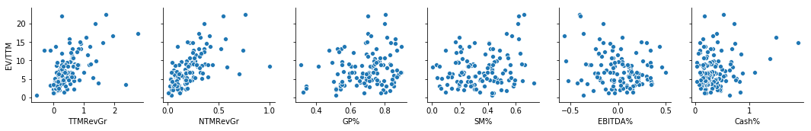
4. Modelling (1/1)
Data Exploration
Objective: To pre-emptively discover trends and anomalies in the dataset.
Dataset Features
Notable Observations
 | EV/TTM | TTMRevGr | NTMRevGr | GP% | SM% | EBITDA% | Cash%
mean | 7.52 | 0.48 | 0.21 | 0.69 | 0.35 | 0.01 | 0.36
std | 4.47 | 0.50 | 0.17 | 0.13 | 0.17 | 0.22 | 0.29
min | 0.58 | -0.57 | 0.01 | 0.31 | 0.01 | -0.56 | 0.03
0.25 | 4.32 | 0.16 | 0.09 | 0.60 | 0.21 | -0.14 | 0.18
0.50 | 6.64 | 0.35 | 0.18 | 0.71 | 0.34 | 0.03 | 0.29
0.75 | 9.64 | 0.64 | 0.29 | 0.79 | 0.46 | 0.16 | 0.46
max | 22.47 | 2.77 | 1.00 | 0.90 | 0.73 | 0.50 | 1.88
Large Deviation in TTM Revenue Growth and NTM Revenue Growth: NTM revenue growth for all companies was set conservatively, the difference between 1st and 3rd quartile being only 20%. Suggests either a drop-off in market expectations or conservatism in analyst estimates. Compared to TTM revenue growth which has a 48% difference between the 1st and 3rd quartiles as well as a max growth rate of 277%.
Small Deviations in Gross Profit %: The first and third quartiles only differed by about 19% with the maximum value only 30% above the 1st quartile.
Variable Correlations
0.51
0.61
0.20
0.21
(0.21)
0.17
Revenue growth identified as most heavily correlated features with the EV / TTM revenue multiple.
Source: Bloomberg, Team Analysis

Slide 7
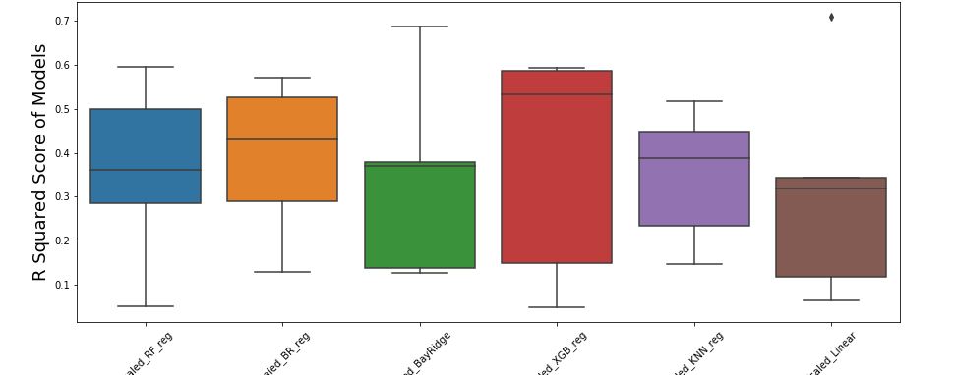
5. Model Exploration (1/1)
Model Exploration
Objective: To test various machine learning algorithms before selecting a subsection to use for modelling the dataset.
Model Methodology
Model Results (R-Squared)
Uniform Scaling: Applied a scaling algorithm to the dataset to normalize mean at 0. Enabled algorithms to be scored by the same metric.
Model Testing: Applied 17 regression algorithms to the dataset with normal parameters to cover a wide range of potential predictions.
Cross Validation: Applied 5 K-Fold cross validations per regression technique to obtain an average score for each technique and related min / max / standard deviation data.
Model Name | R-Squared | Std. Dev
Scaled_BR_reg: | 0.39 | (+/- 0.16)
Scaled_XGB_reg: | 0.38 | (+/- 0.23)
Scaled_RF_reg: | 0.36 | (+/- 0.19)
Scaled_KNN_reg: | 0.35 | (+/- 0.14)
Scaled_BayRidge: | 0.34 | (+/- 0.20)
Scaled_Linear: | 0.31 | (+/- 0.23)
Model Testing

Slide 8
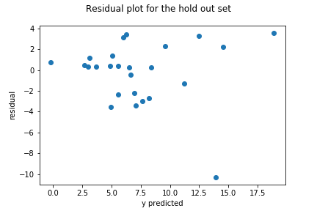
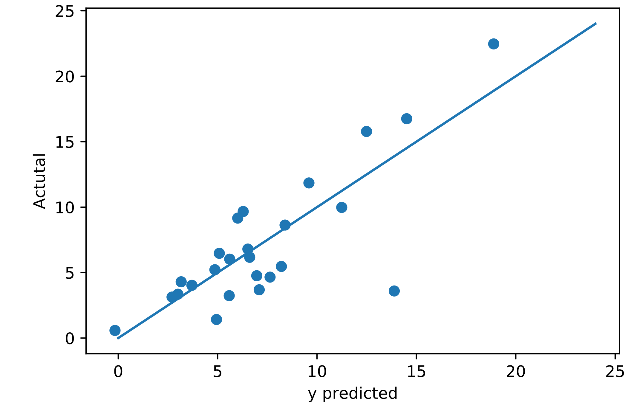
6. Regression Results (1/2)
Linear Regression
A Linear Regression was used as the baseline for modelling. When applied to a randomly selected test set (25 samples), the linear model performed quite well, with an R-Squared of 65.4%. The model’s coefficients show that NTM revenue growth was the biggest predictive factor.
Model Coefficients
Model Features
Constant | (2.59)
Revenue Growth | 3.65
NTM Revenue Growth | 12.00
GP Margin | 8.62
S&M % of Revenue | -1.59
EBITDA % of Revenue | 1.09
Cash % of Revenue | 1.10
R Squared | 0.654 | Suggests that roughly 65% of the variability in EV/TTM can be explained by our variables.
Mean Squared Error | 2.954 | On average, the margin of error between the predicted values and the actual values.
Preliminary Results
Residual Plot
72% of test population predicted within + / - 3
Source: Bloomberg

Slide 9
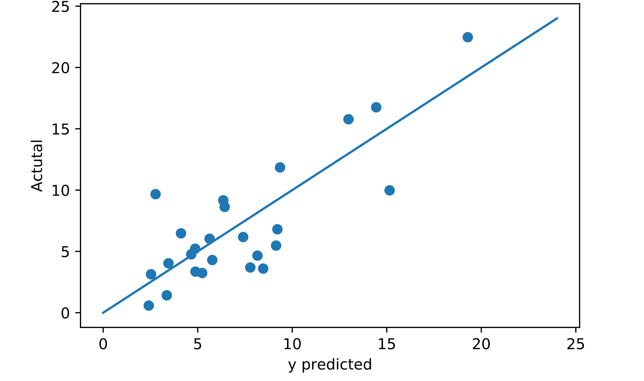
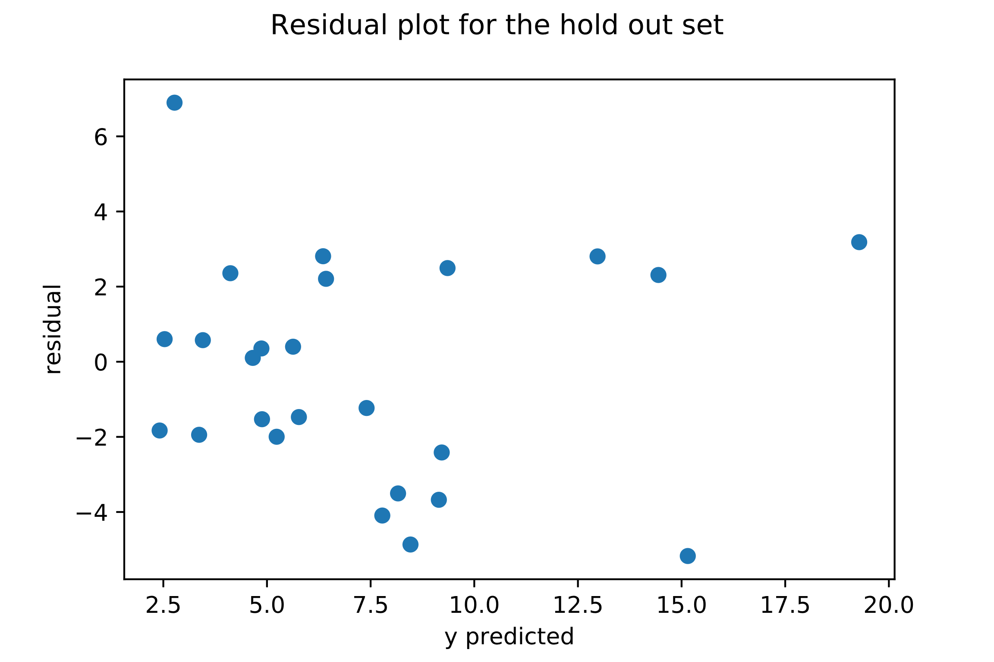
6. Regression Results (2/2)
Bagging Regression
A bagging regression was used as the comparison to linear regression due to its highest average r-squared during the model selection. When applied to a randomly selected test set (25 samples), the bagging model received a slightly higher r-squared of 66.3%.
Model Features
Model Coefficients
Model Features
Model Training Concept
R Squared | 0.663 | Suggests that roughly 66% of the variability in EV/TTM can be explained by our variables.
Mean Squared Error | 2.914 | On average, the margin of error between the predicted values and the actual values.
Full Population
Training Sets
Avg Model
Preliminary Results
Residual Plot
72% of test population predicted within + / - 3
Source: Bloomberg

Slide 10
7. Application (1/2)
4. Application to Khazanah Prospective Companies
By applying the training model to several of Khazanah’s former prospective companies, a rough comparison of the effectiveness of the two models was created. Overall, the Bagging Regression performed better than the Linear Model and generated less variance from the true values.
Examined Companies
Feature* | Databricks | Velocloud | Crowdstrike | Mesosphere
TTM Revenue (USD’m) | 66.7 | 28.6 | 239.5 | 29.0
TTM Revenue Growth Rate | 124.7% | 273.4% | 107.2% | 168.5%
NTM Revenue Growth Rate | 95.2% | 101.3% | 91.4% | 67.0%
Gross Margin | 67.1% | 61.7% | 64.1% | 76.0%
S&M % of Revenue | 98.2% | 52.0% | 83.8% | 129.7%
EBITDA Margin | (114.9%) | (108.3%) | (77.4%) | (269.7%)
Cash % of Revenue | 188.9% | 104.2% | 147.2% | 193.1%
* Data fitted to the YE of the deal’s closing, Projected numbers from management used when available
Multiples Comparison
EV Comparison (USD ‘m)
Multiples | Actual | Linear | Bagging
Databricks | 17.99** | 18.44 | 18.76
Velocloud | 11.19 | 24.01 | 18.12
Crowdstrike | 13.15 | 17.27 | 18.84
Mesosphere | 22.41 | 17.08 | 19.22
Valuation | Actual | Linear | Bagging
Databricks | 1200** | 1230 | 1252
Velocloud | 320 | 687 | 518
Crowdstrike | 3150 | 4135 | 4512
Mesosphere | 650 | 495 | 557
**USD1200m used as estimate for Databricks’ valuation based on team’s first IC presentation, Post-Money Valuation (EV) from PitchBook
Source: PitchBook, Company Data, Team Analysis

Slide 11
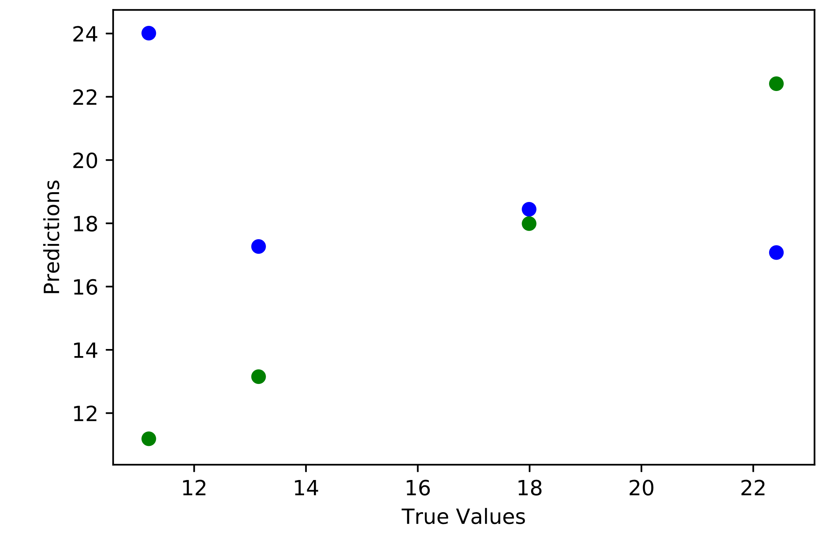
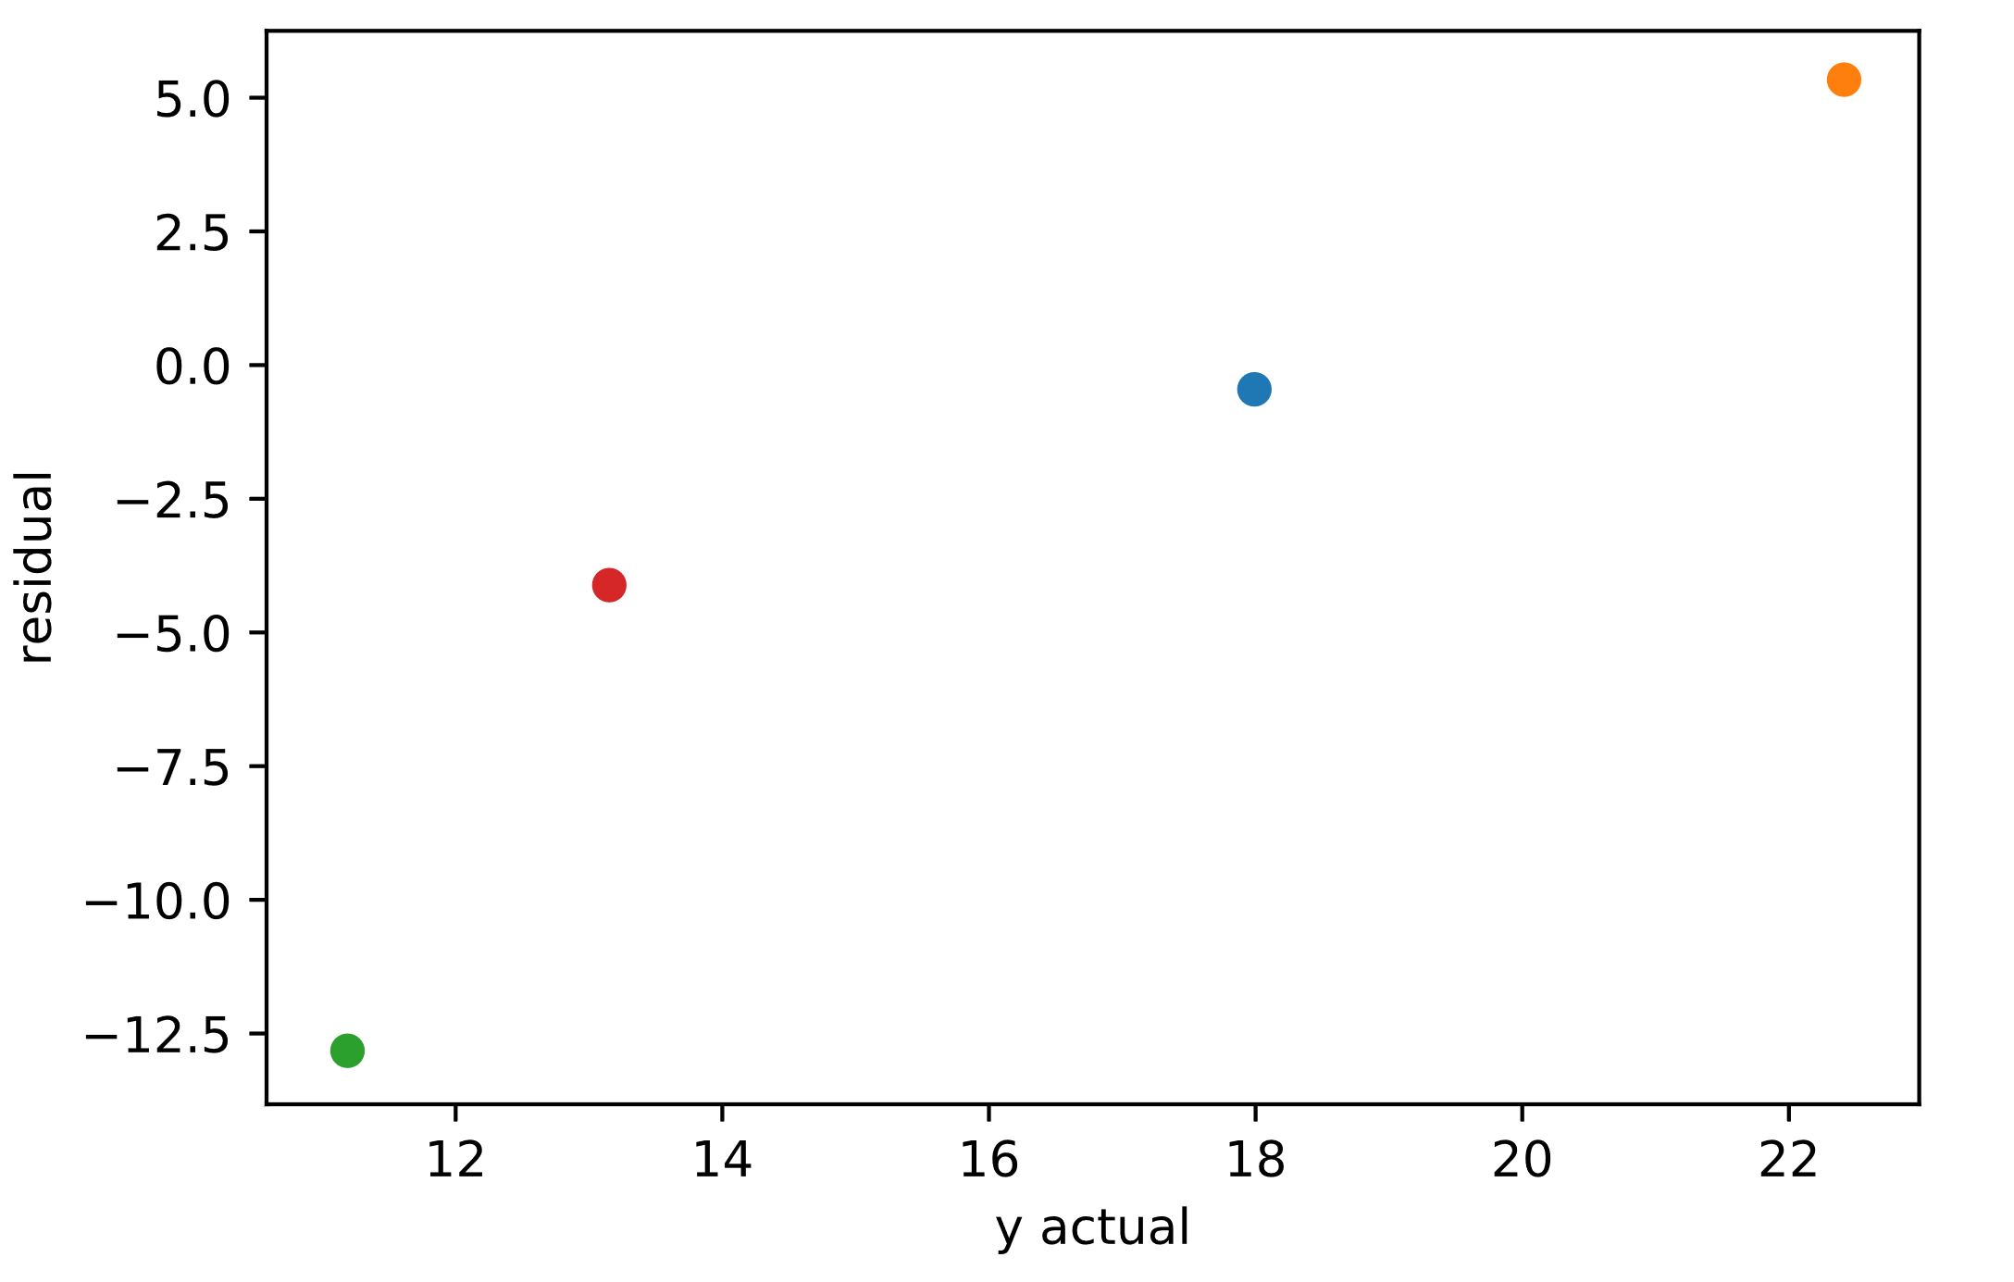
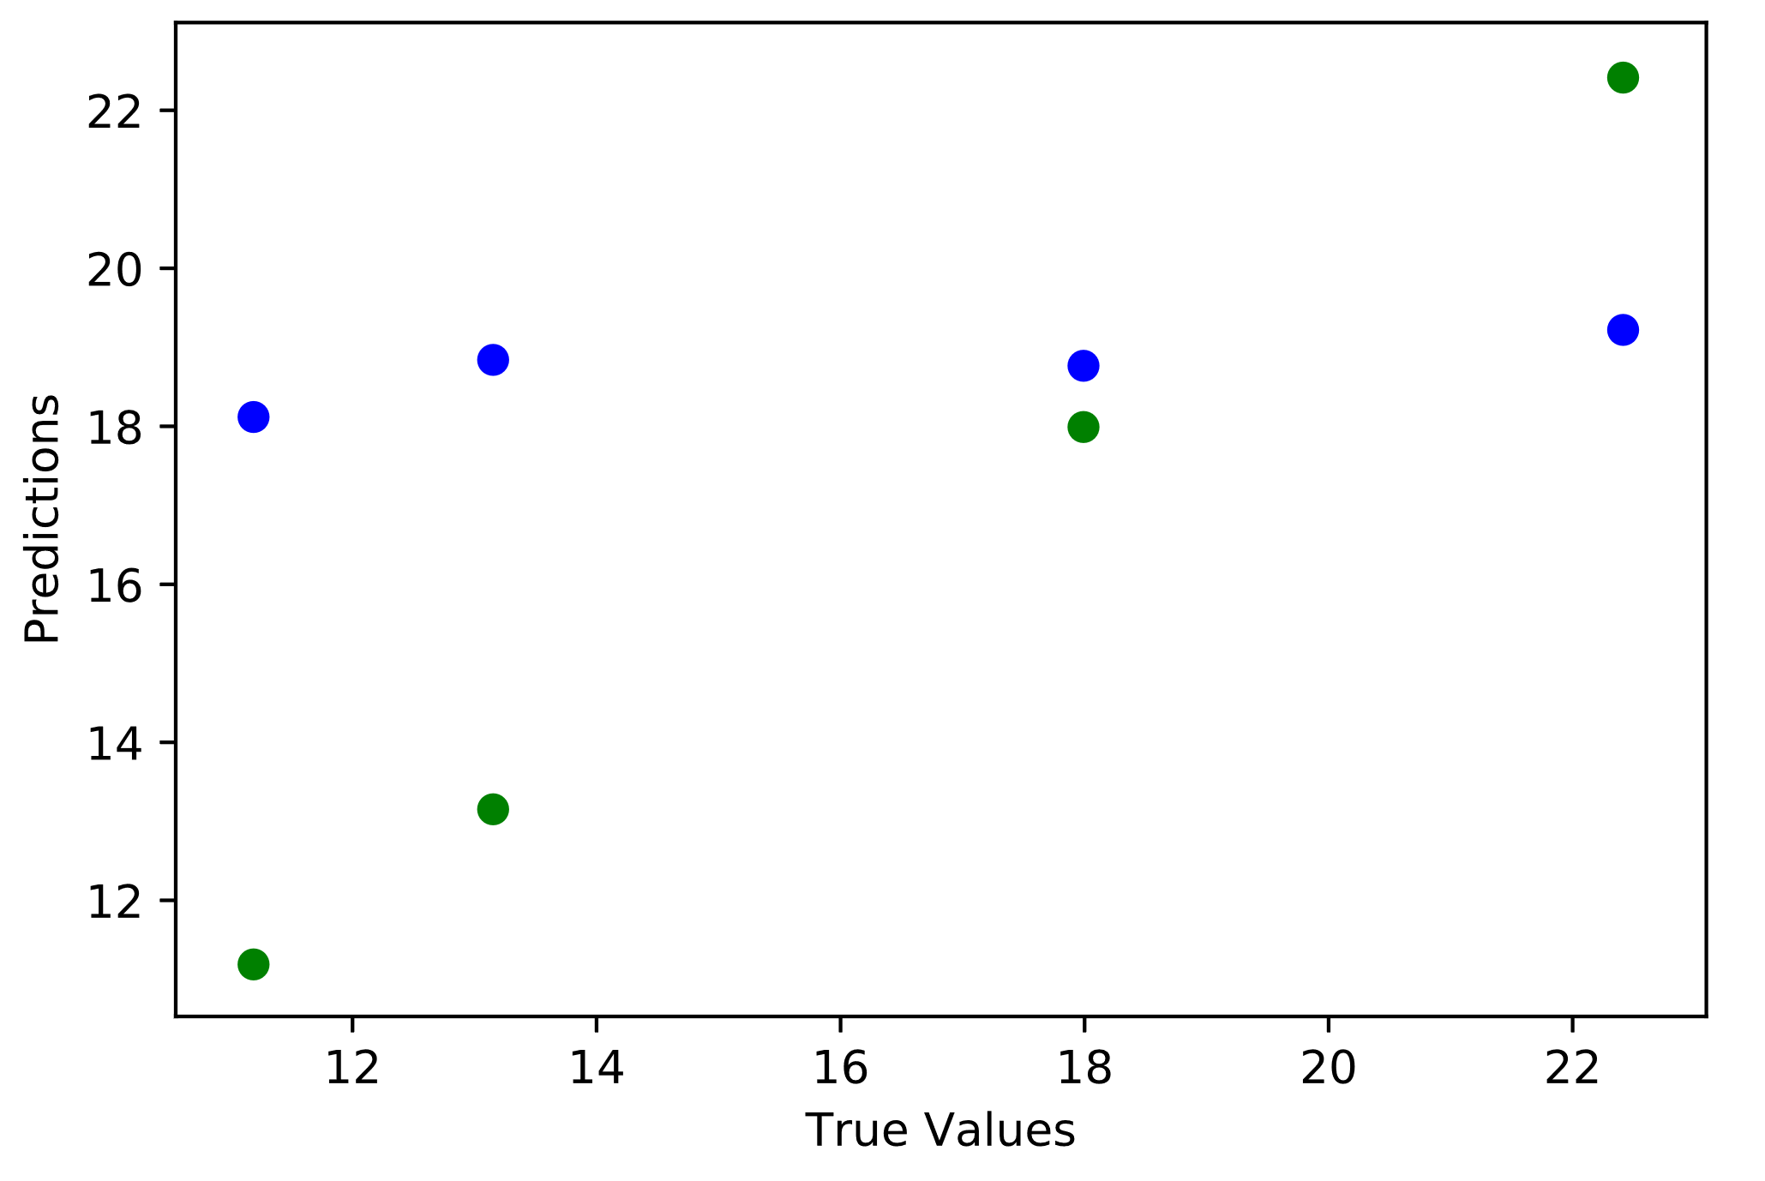
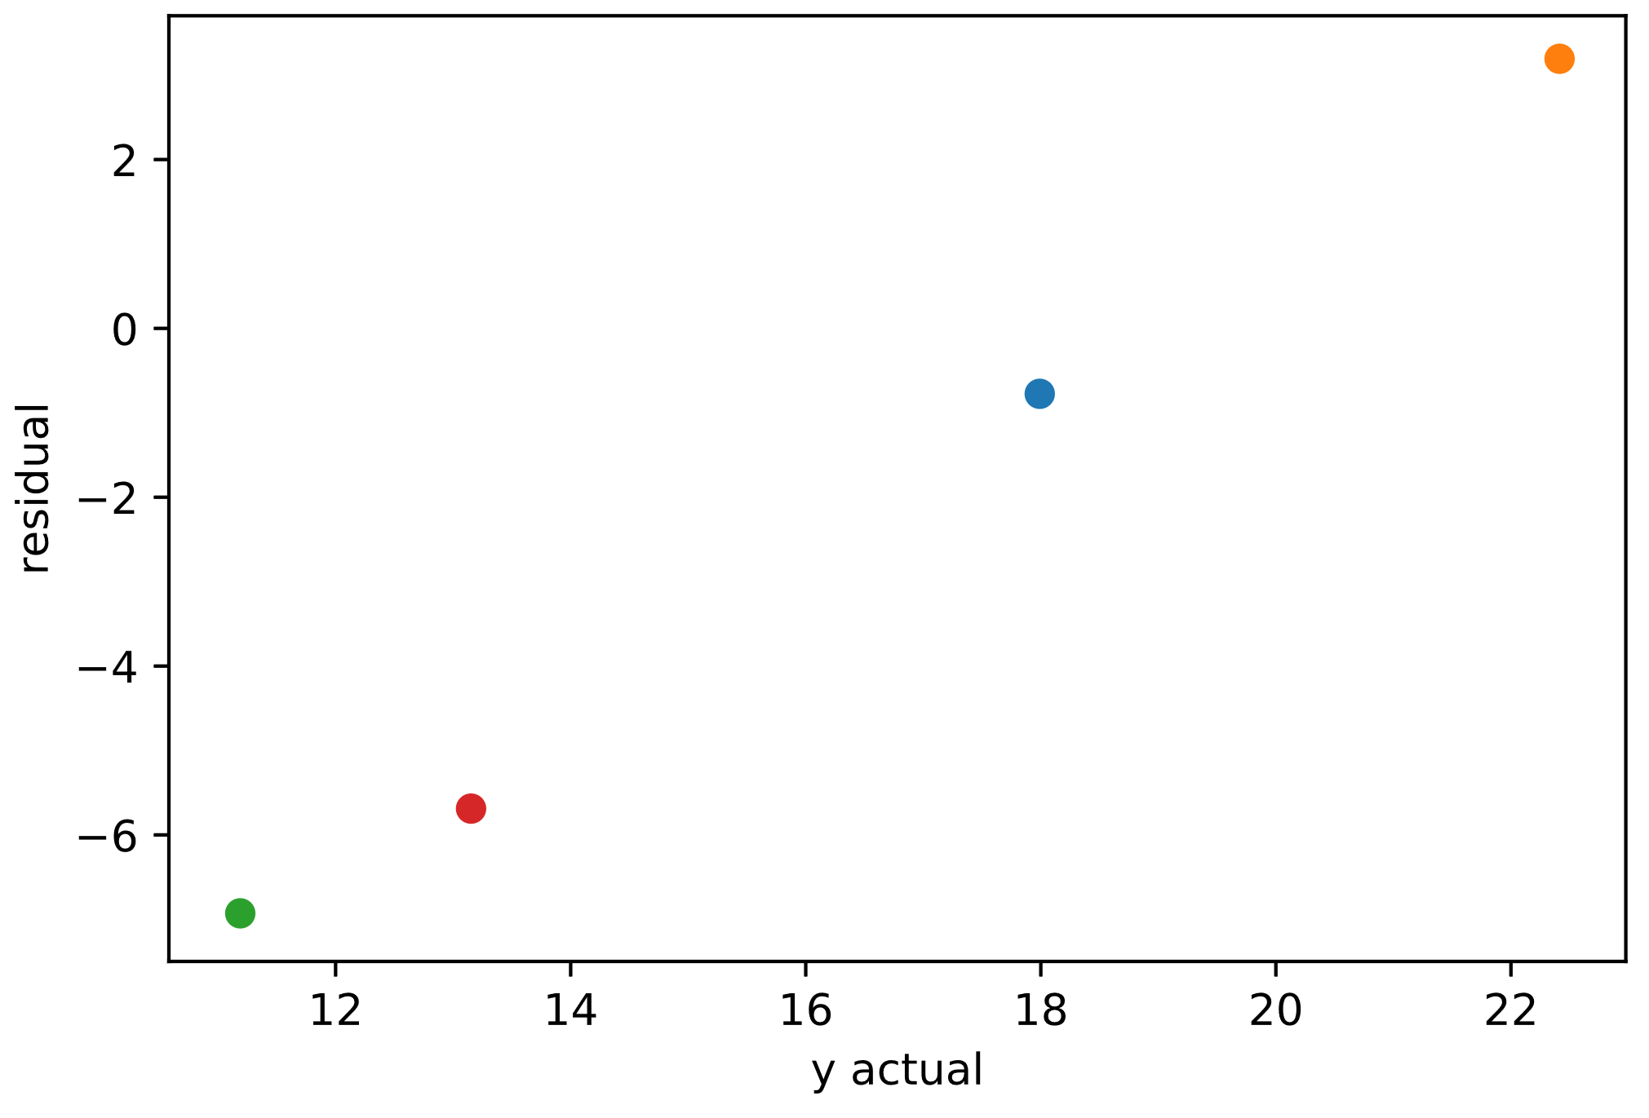
7. Application (2/2)
Linear Model Predictions vs. Actual
Multiple Residuals (Actual – Predicted)
Velocloud
Mesosphere
Databricks
Databricks
Crowdstrike
Mesosphere
Crowdstrike
Predicted
Velocloud
Actual
Bagging Model Predictions vs. Actual
Multiple Residuals (Actual – Predicted)
Mesosphere
Mesosphere
Crowdstrike
Databricks
Databricks
Predicted
Crowdstrike
Velocloud
Actual
Velocloud
Source: PitchBook, Company Data, Team Analysis

Slide 12


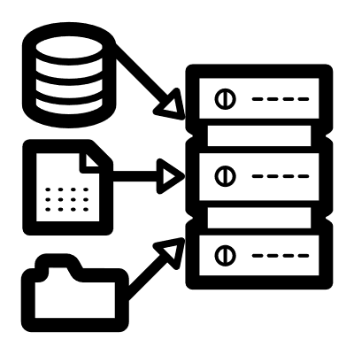


8. Risks and Next Steps (1/1)
 | Risks | Potential Mitigation
Quality and Size of Dataset | Inaccurate Projections: The revenue growth rate retrieved from Bloomberg is based off of analyst projections that are not guaranteed to be accurate. A portion of the data retrieved was also incomplete (missing one or more of analyzed variables), and incomplete datasets were removed from the analysis, potentially skewing or biasing the companies analyzed. Weak Comparables: Additionally, many companies added cannot be considered direct competitors or comparison companies to Databricks, the overall pool should be carefully re-examined and refreshed for future analysis. | Add and test additional features, potentially look into categorical or qualitative features like strength of management, positioning amongst competitors etc. Segment the population further by age / stage in growth to capture a more comparable peer group. Consider utilizing a pool of strictly private company data, potentially pulled from company S-1s prior to IPO. Trade-off lies in the loss of time-value, as each company’s IPO date and surrounding market conditions will be completely different.
Modelling | Large Deviations in R-Squared: The model may be overfitting and not truly perform as well as it appears simply due to the low sample size in the given data. While 5x cross-validation was used in this study, when increased to 10x (the industry average), the deviation in r squared values rose significantly, likely due to the small test sets (~25 companies). Poor Model Tuning: The models were not adequately hypertuned and that presents an opportunity going forward. | Consider imputation techniques to address the problem encountered with missing data to expand the dataset. Consider hypertuning models further to test for possible improvements. Work on automating the intake and processing of internal and external data – potentially through a cloud-shared Excel datasheet.
Difficulty Extrapolating | Poor Application to Private Companies: While both models performed well against a set of test companies from public markets, both models had problems extrapolating to companies like Databricks, Velocloud, Crowdstrike, and Mesosphere. | Create new datasets with more approximate comparable companies. Add additional relevant features to improve model performance.
Next Steps
Increase Dataset
Test New Features
Track Private Companies
Try New Angles
Test New Tech
Consider Imputing Features
Consider Qualitative Features
Create our Own Dataset
Compare Different Years
Consider Neural Nets

Slide 13
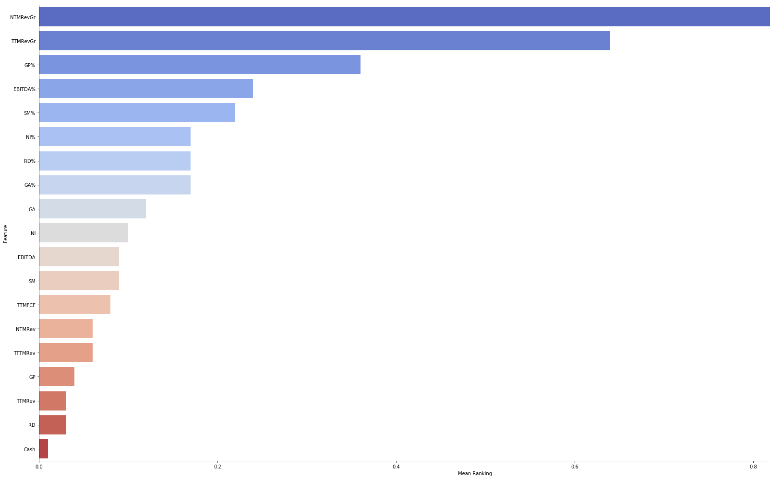

Slide 14
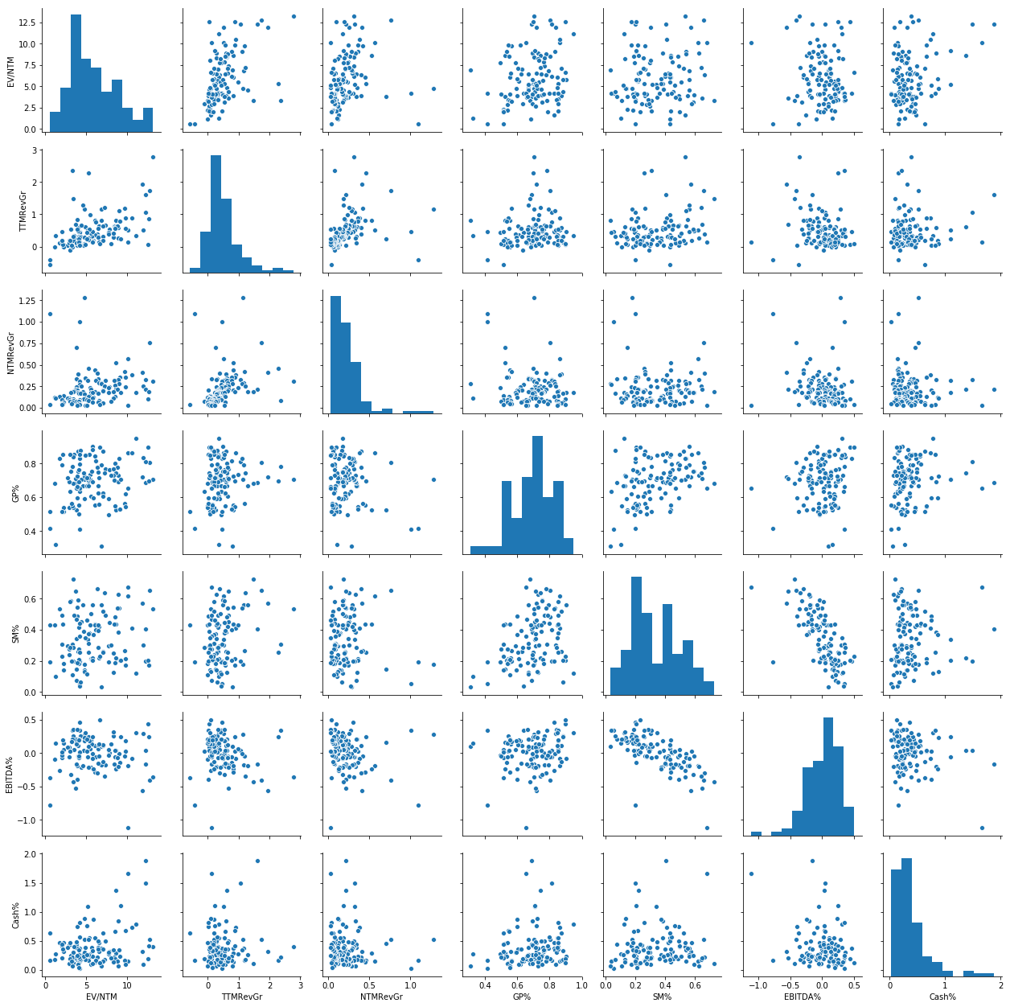

Slide 15
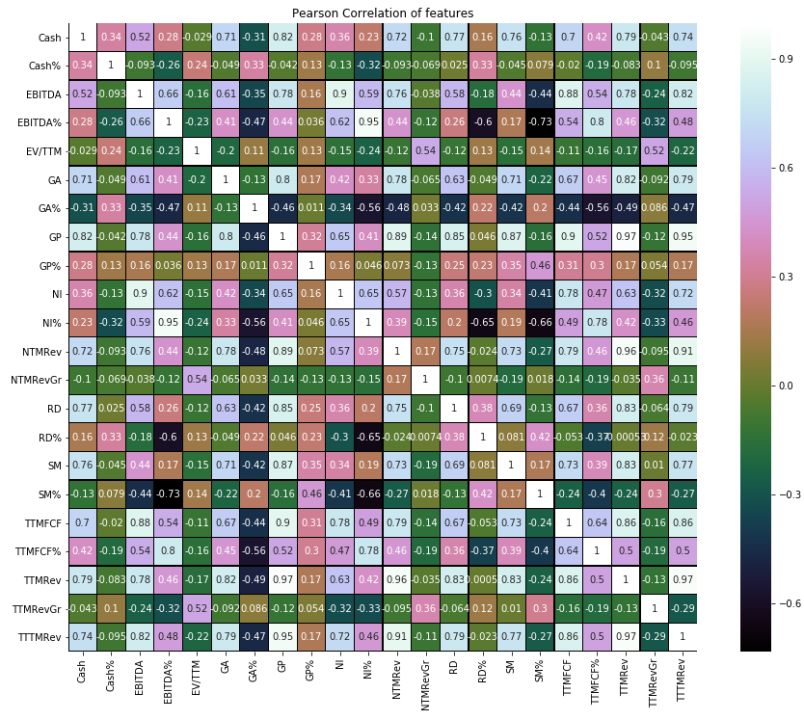

Slide 16
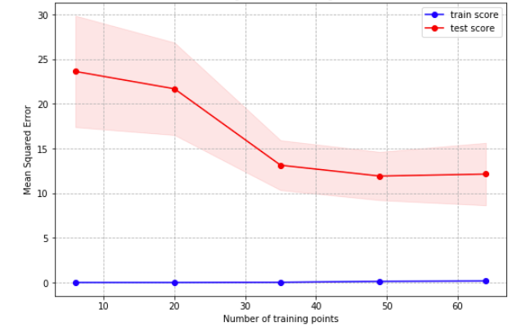
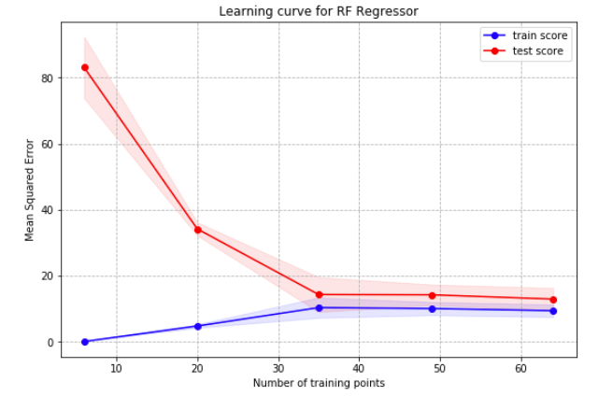
Model Features
Model Coefficients
Linear
Bagging Regressor

